Slide 1
Learning Objective
I will be able to determine the period, amplitude, domain and range
Success Criteria
At the end of the lesson, I will be able to:
Determine the determine the period, amplitude, domain and range of sine and cosine graphs

Slide 2
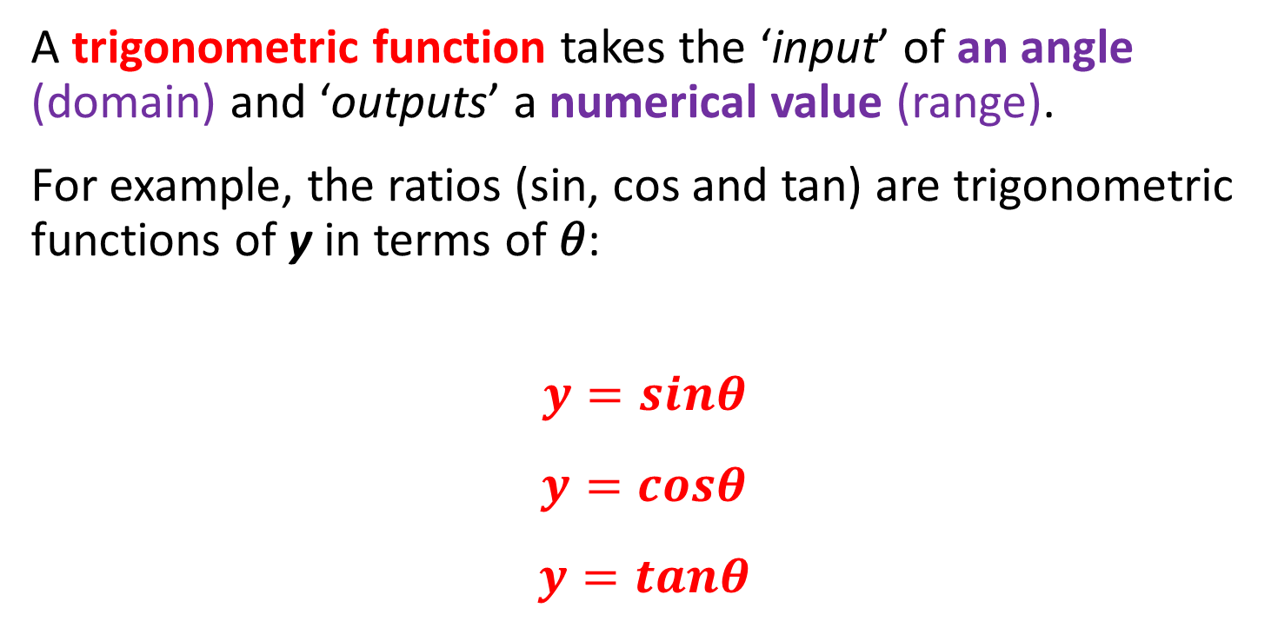
Trigonometric Functions (Periodic Functions)
Concept Development
A trigonometric function takes the ‘input’ of an angle (domain) and ‘outputs’ a numerical value (range).
For example, the ratios (sin, cos and tan) are trigonometric functions of y in terms of 𝜃:
$$y=sinθ$$
$$y=cosθ$$
$$y=tanθ$$

Slide 3
Features of Trigonometric (Periodic) Functions
Concept Development
There are two key features of any trigonometric (periodic) function:
Amplitude - the ‘height’ of the wave, from equilibrium to ‘crown’ (i.e the extrema). (The distance between the mean position and the maximum position)
Period - the angle required before the wave ‘repeats’.
Also thought of as the ‘time taken to repeat one cycle’.

Slide 4
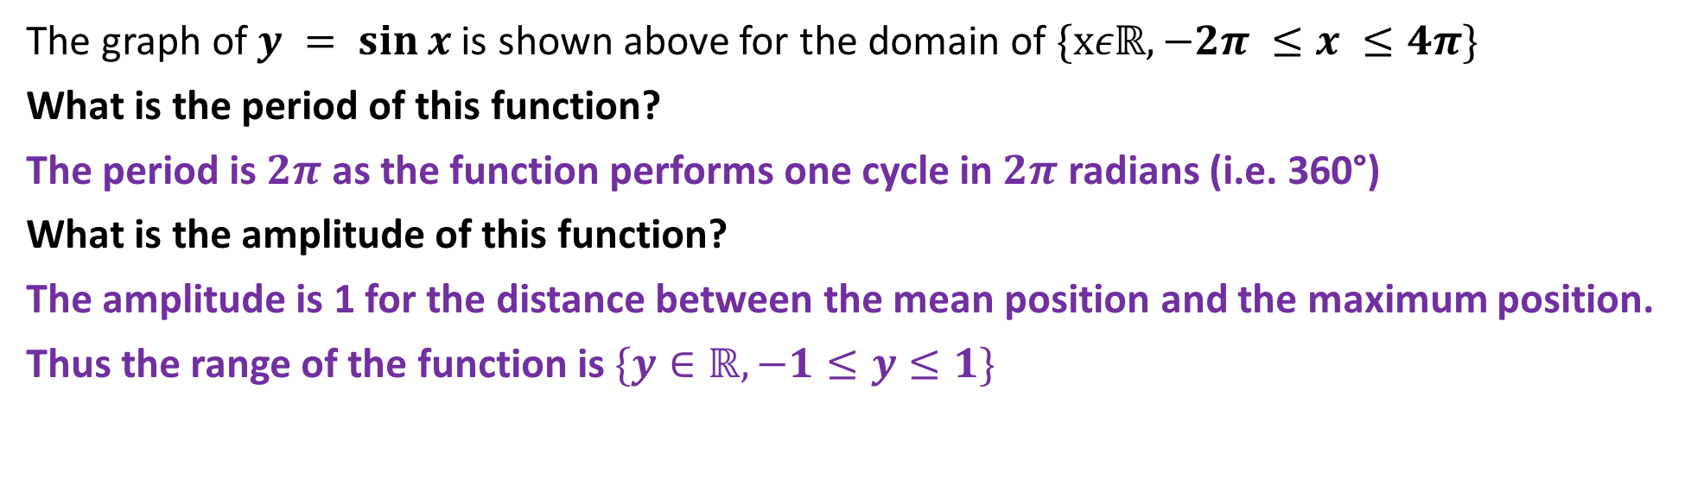
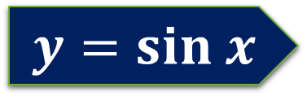
$$y=sin x$$
The graph of $y = sin⁡x$is shown above for the domain of $\{xεℝ,−2π ≤x ≤4π\}$
What is the period of this function?
The period is $2π$ as the function performs one cycle in $2π$ radians (i.e. 360°)
What is the amplitude of this function?
The amplitude is 1 for the distance between the mean position and the maximum position.
Thus the range of the function is $\{y∈ℝ,−1≤y≤1\}$

Slide 5
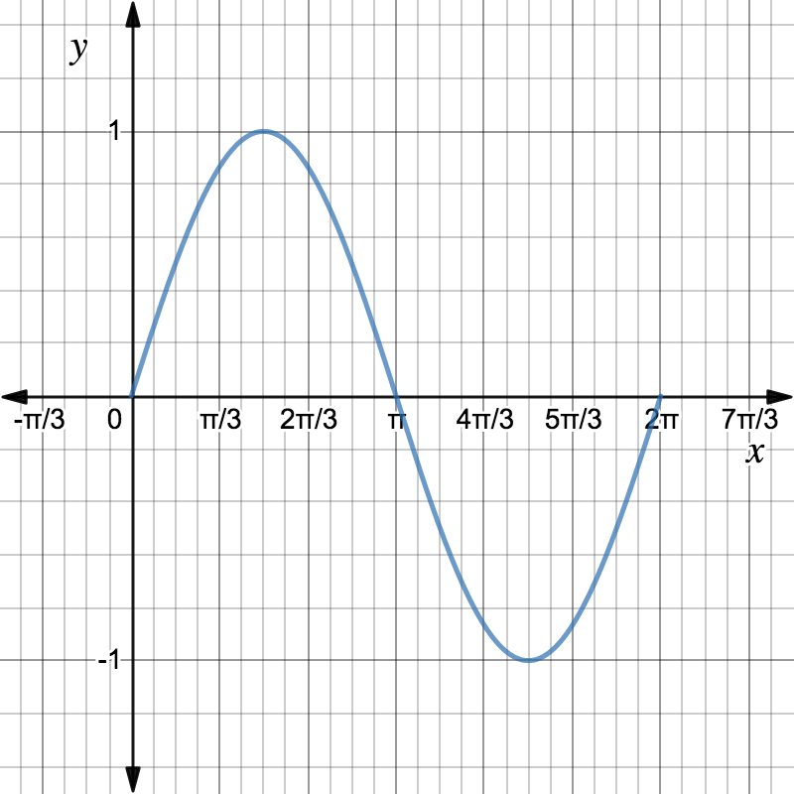
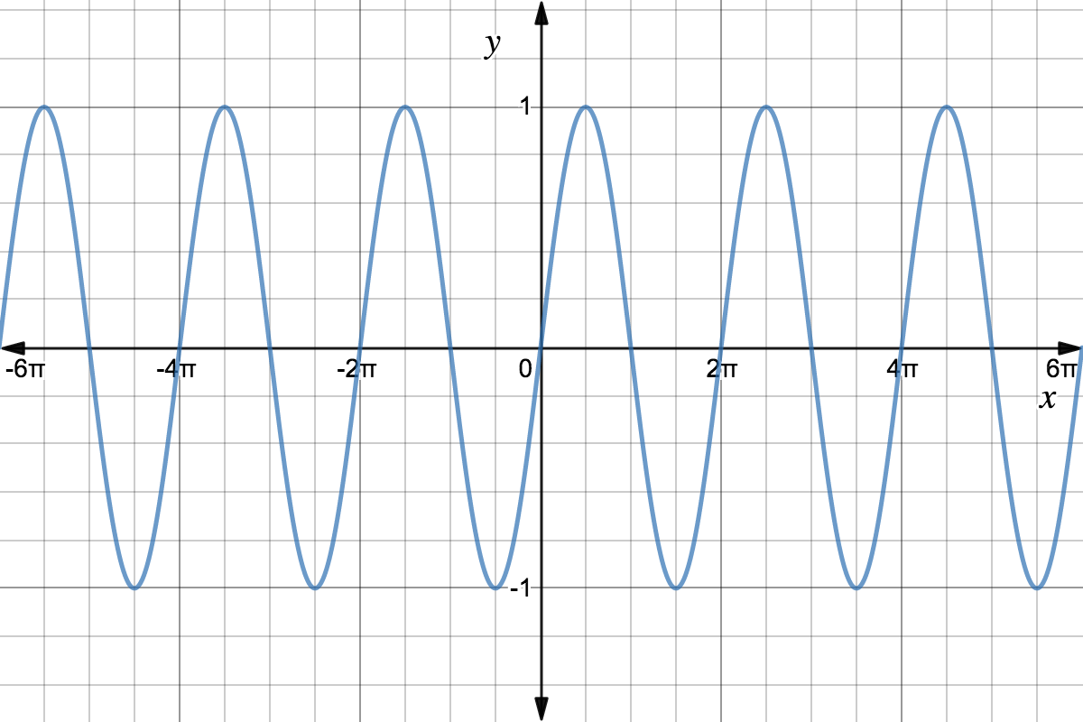


Features of the Sine Function
Concept Development
Amplitude
Period
$$1$$
$$2π or 360°$$

Slide 6
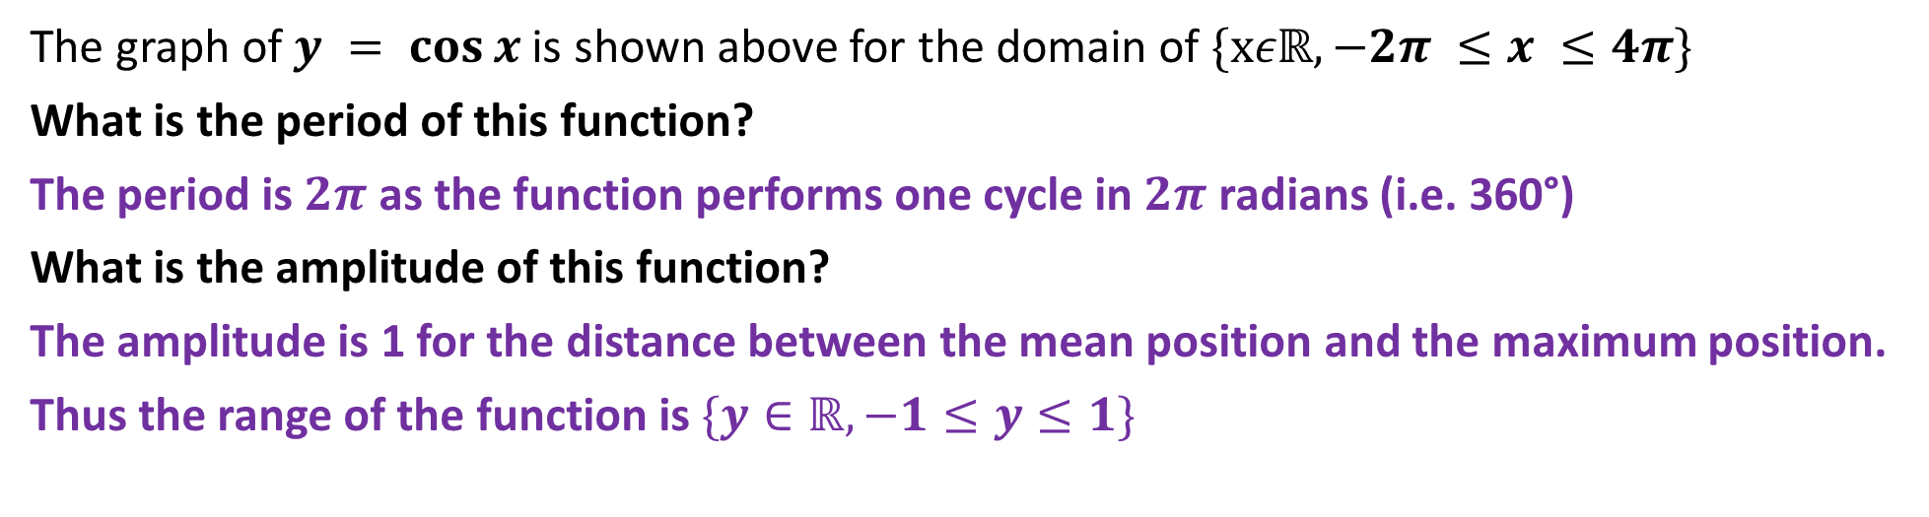
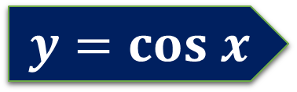
$$y=cos x$$
The graph of $y = cos⁡x$is shown above for the domain of $\{xεℝ,−2π ≤x ≤4π\}$
What is the period of this function?
The period is $2π$ as the function performs one cycle in $2π$ radians (i.e. 360°)
What is the amplitude of this function?
The amplitude is 1 for the distance between the mean position and the maximum position.
Thus the range of the function is $\{y∈ℝ,−1≤y≤1\}$

Slide 7
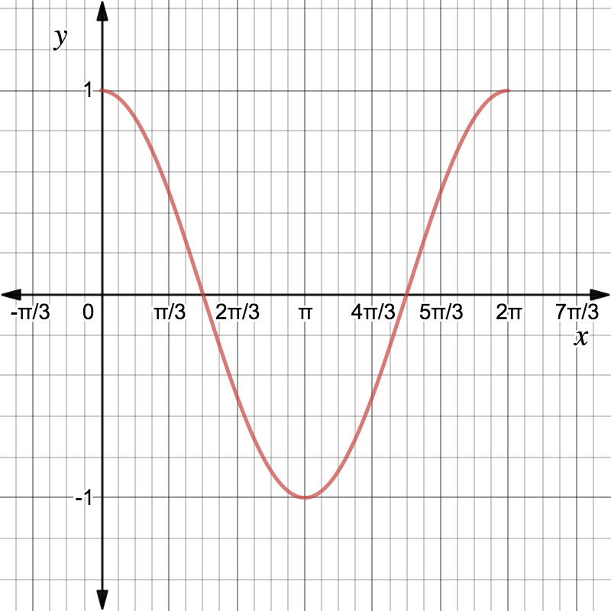
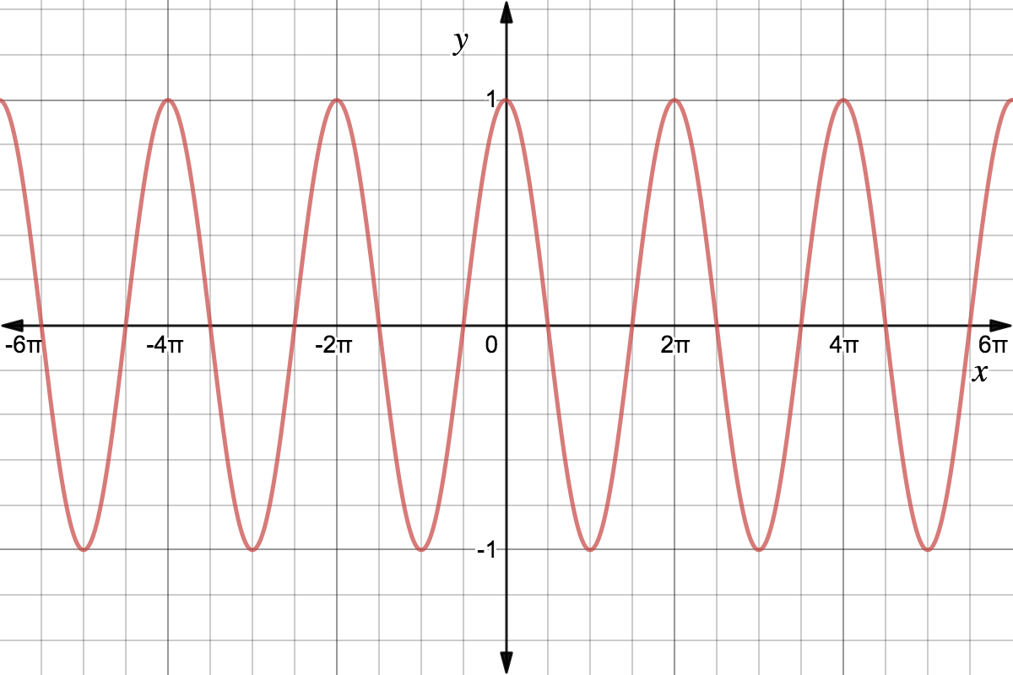


Features of the Cosine Function
Concept Development
Amplitude
Period
$$1$$
$$2π or 360°$$

Slide 8
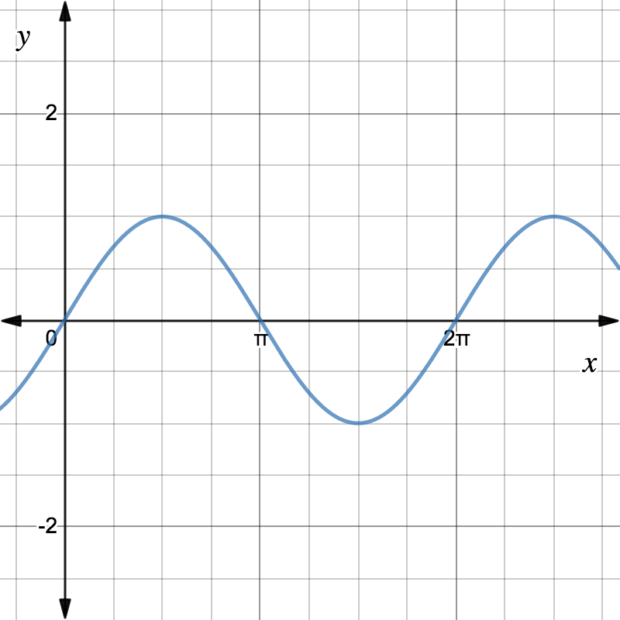
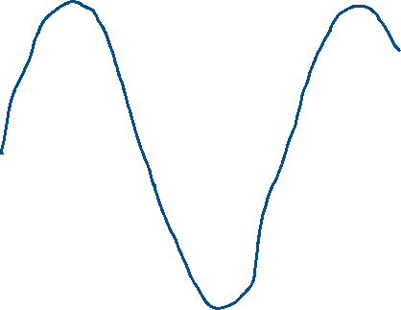

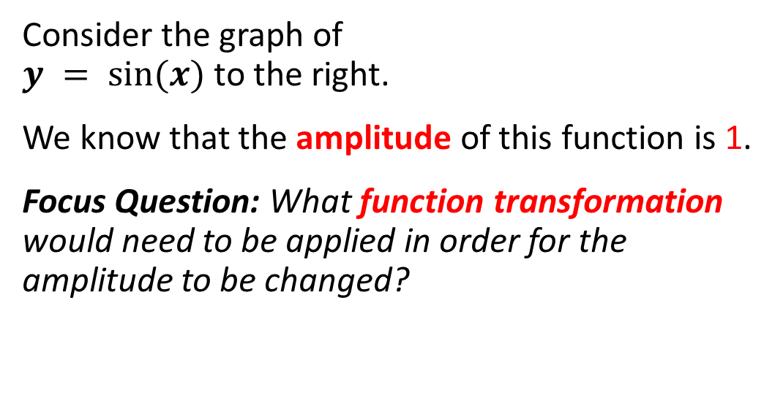
Change in amplitude
Concept Development
Consider the graph of
$y = sin⁡(x)$to the right.
We know that the amplitude of this function is 1.
Focus Question: What function transformation would need to be applied in order for the amplitude to be changed?
Use your classpad to plot
$$y = sin⁡(x)$$
Then experiment to see how you could change the amplitude.

Slide 9
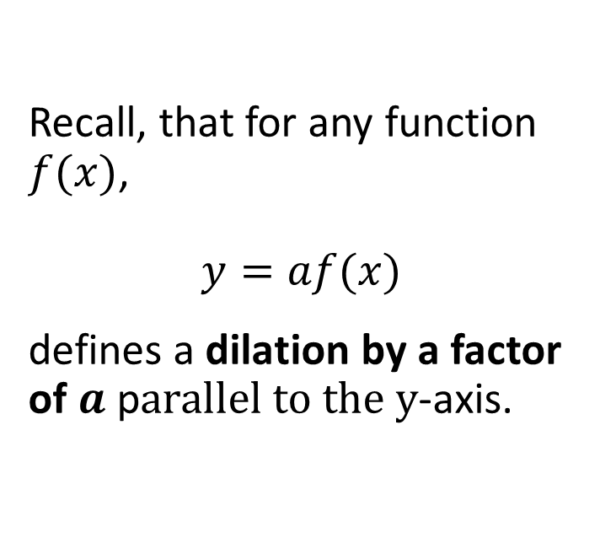
Dilation parallel to the y-axis (a)
Concept Development
Recall, that for any function $f(x)$,
$$y=af(x)$$
defines a dilation by a factor of $a$ p$arallel to the y$-axis.

Slide 10
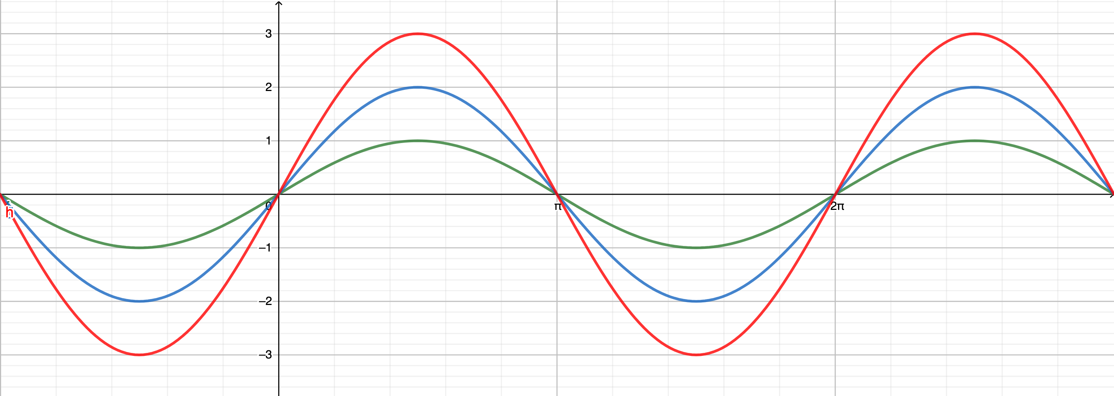

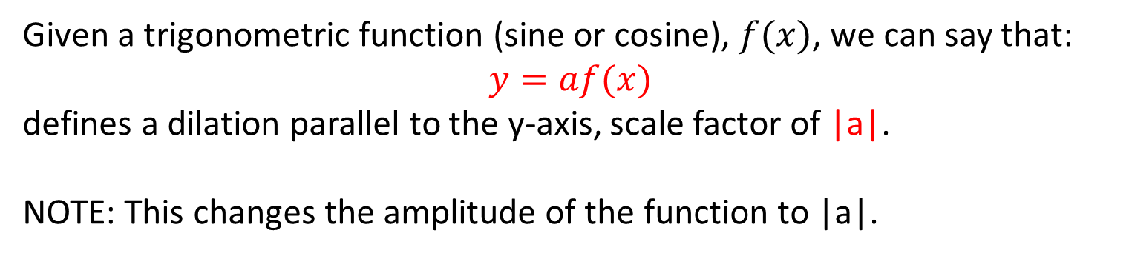


Concept Development
Change in Amplitude - (A dilation parallel to $y$-axis)
$$y=3sin⁡(x)$$
$$y=sin⁡(x)$$
$$y=2sin⁡(x)$$
Given a trigonometric function (sine or cosine), $f(x)$, we can say that:
$$y=af(x)$$
defines a dilation parallel to the y-axis, scale factor of |a|.
NOTE: This changes the amplitude of the function to |a|.

Slide 11

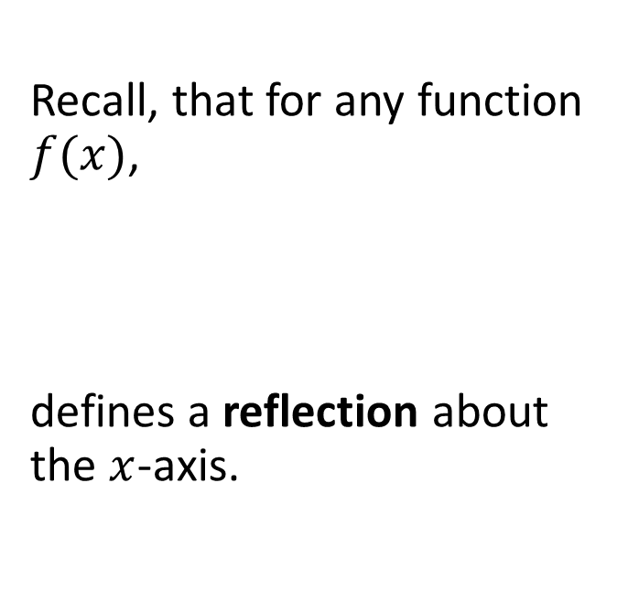
Reflection about the x-axis (a = -1)
Concept Development
Recall, that for any function $f(x)$,
defines a reflection about the $x$-axis.

Slide 12
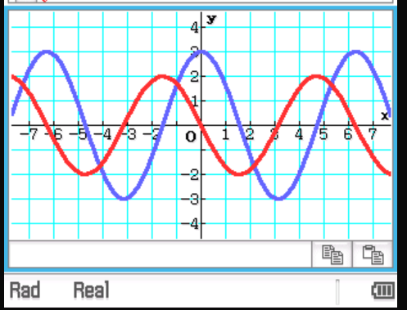
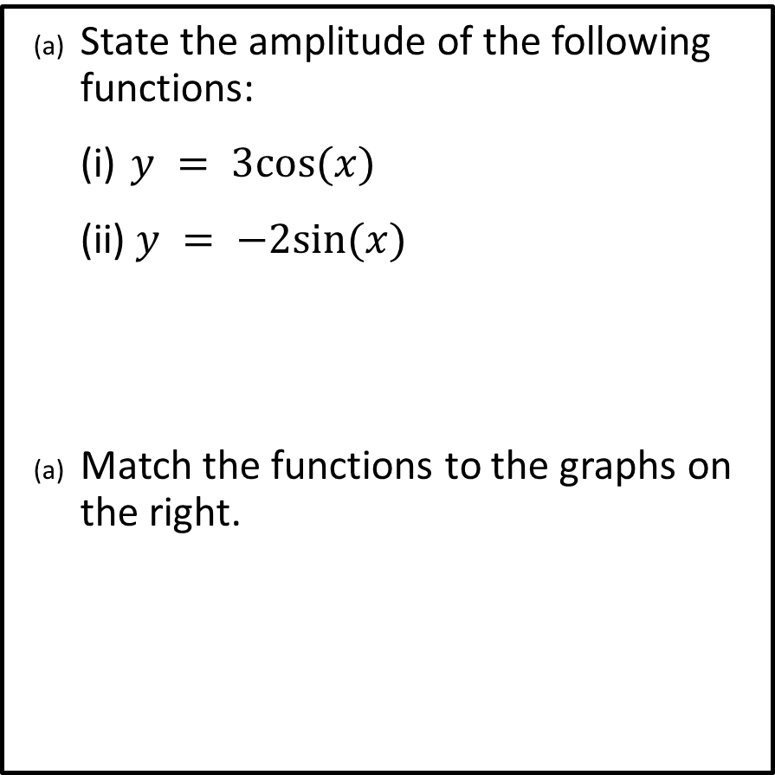


Example
Guided Practice
State the amplitude of the following functions:
(i) $y = 3cos⁡(x)$
(ii) $y = −2sin⁡(x)$
Match the functions to the graphs on the right.
$$3\cos{(x)}$$
3
2
$$3\cos{(x)}$$

Slide 13
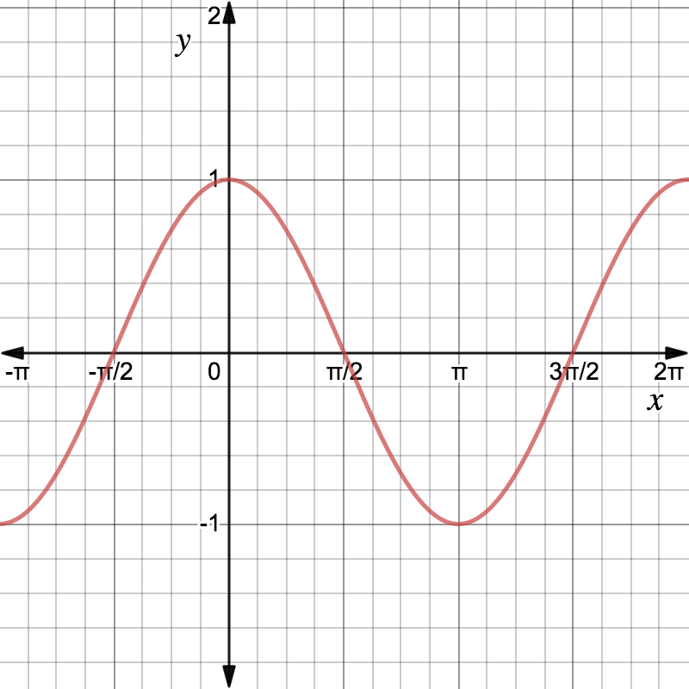

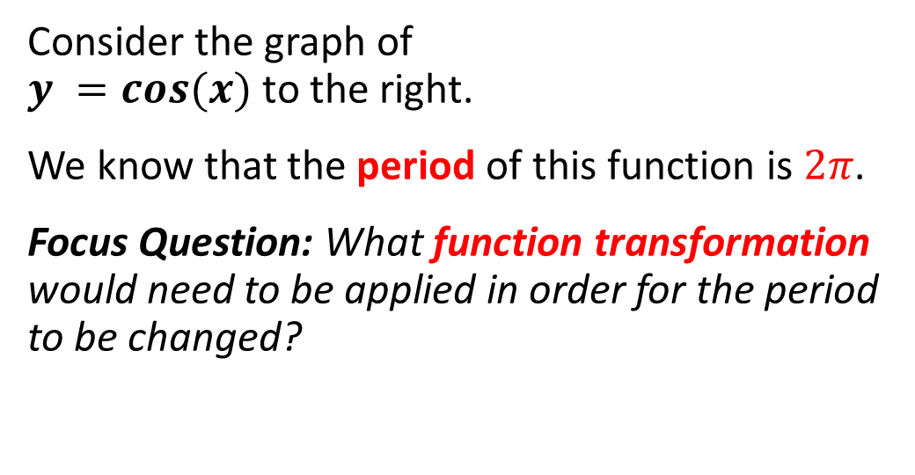
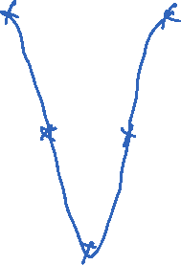
Change in period
Concept Development
Consider the graph of
$y =cos⁡(x)$to the right.
We know that the period of this function is $2π$.
Focus Question: What function transformation would need to be applied in order for the period to be changed?
Use your classpad to plot
$$y =cos⁡(x)$$
Then experiment to see how you could change the period.

Slide 14
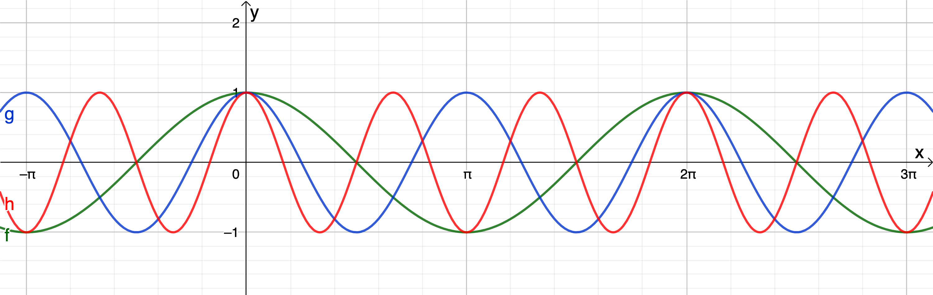





Period of sin(bx) and cos(bx) functions:
Concept Development
Change in Period - (A dilation parallel to $x$-axis)
$$y=cos(x)$$
$$y=cos⁡(3x)$$
$$y=cos⁡(2x)$$
Given a trigonometric function (sine or cosine), $f(x)$, we can say that:
$$y=f(bx)$$
defines a dilation parallel to the y-axis, scale factor of $\frac{1}{b}$.

Slide 15
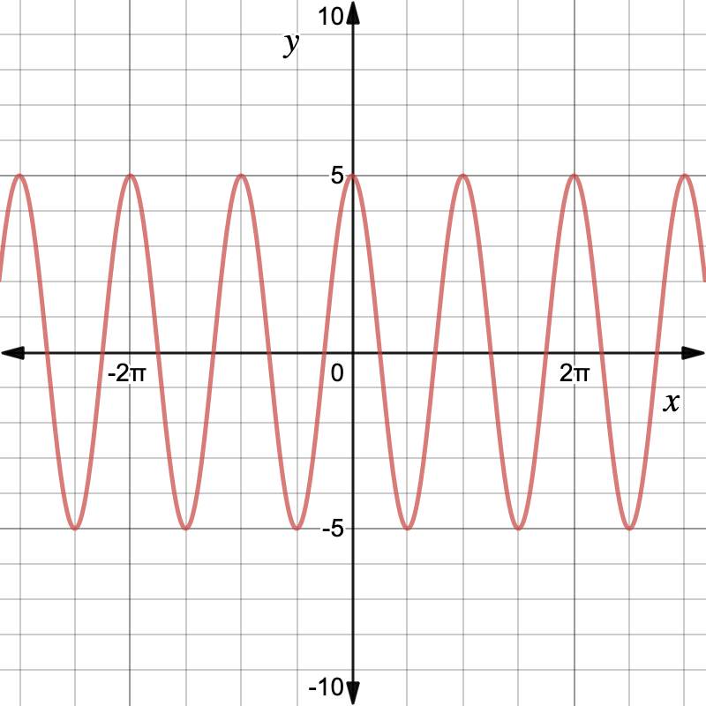
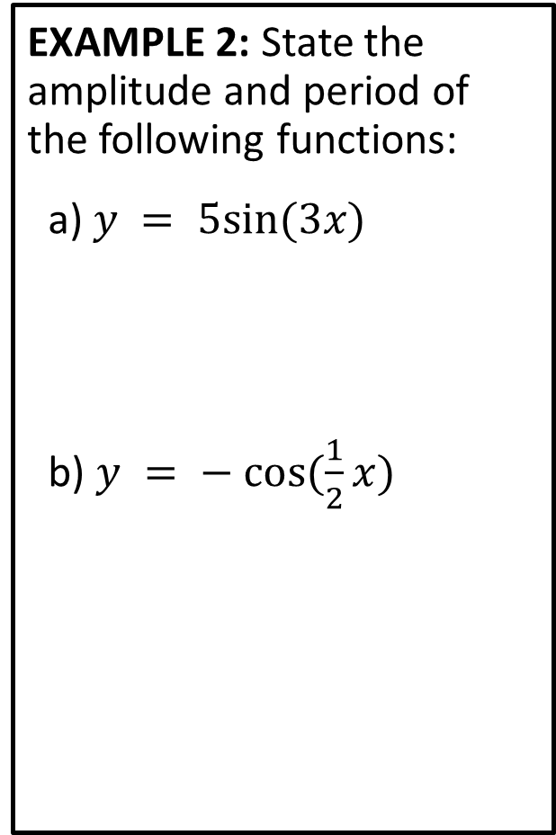
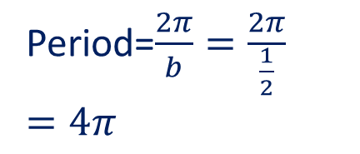




Guided Practice
EXAMPLE 2: State the amplitude and period of the following functions:
a) $y = 5sin⁡(3x)$
b) $y = − cos⁡(\frac{1}{2}x)$
EXAMPLE 3: Determine the equation of the following function in the form of y = a f(bx).
Amplitude=$5$
$$y=a\cos{(bx)} \\ a=5 \\ period=π \\ \frac{2π}{b}=π \\ b=2 \\ y=5cos⁡(2x)$$
Period=$\frac{2π}{b}=\frac{2π}{3}$
Amplitude=$1$
Period=$\frac{2π}{b}=\frac{2π}{\frac{1}{2}}=4π$

Slide 16

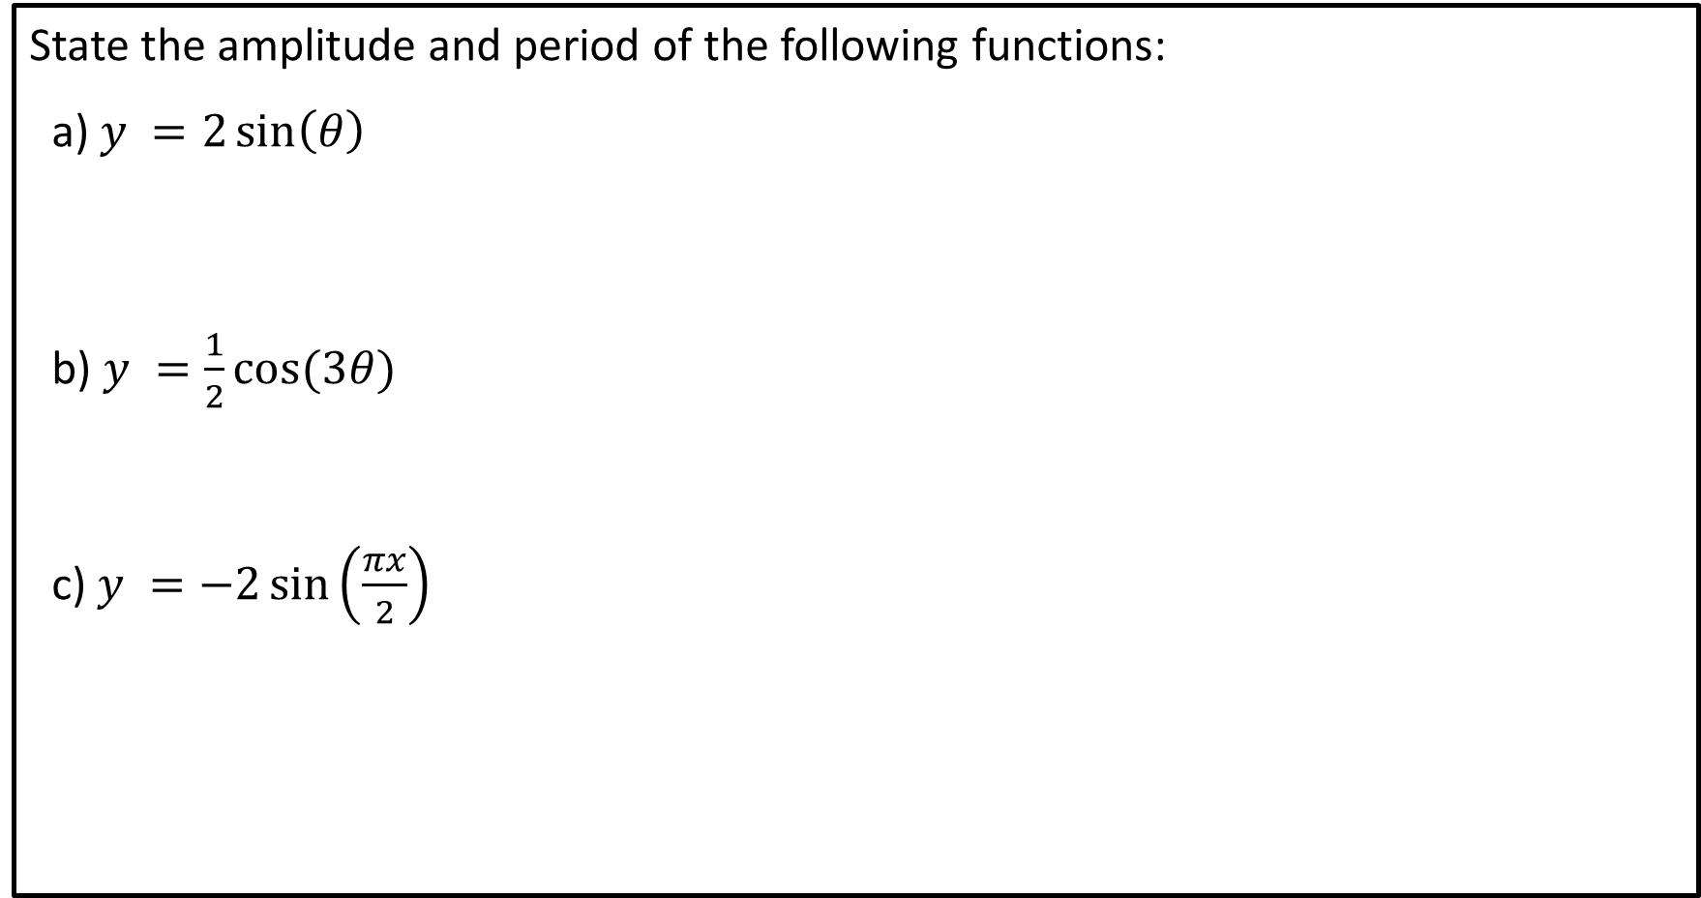




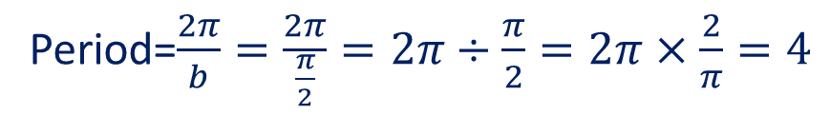
Guided Practice
State the amplitude and period of the following functions:
a) $y =2\sin\left(θ\right)$
b) $y =\frac{1}{2}cos⁡(3θ)$
c) $y =−2\sin\left(\frac{πx}{2}\right)$
Amplitude=$2$
Period=$\frac{2π}{b}=2π$
Amplitude=$\frac{1}{2}$
Period=$\frac{2π}{b}=\frac{2π}{3}$
Amplitude=$2$
Period=$\frac{2π}{b}=\frac{2π}{\frac{π}{2}}=2π÷\frac{π}{2}=2π×\frac{2}{π}=4$

Slide 17
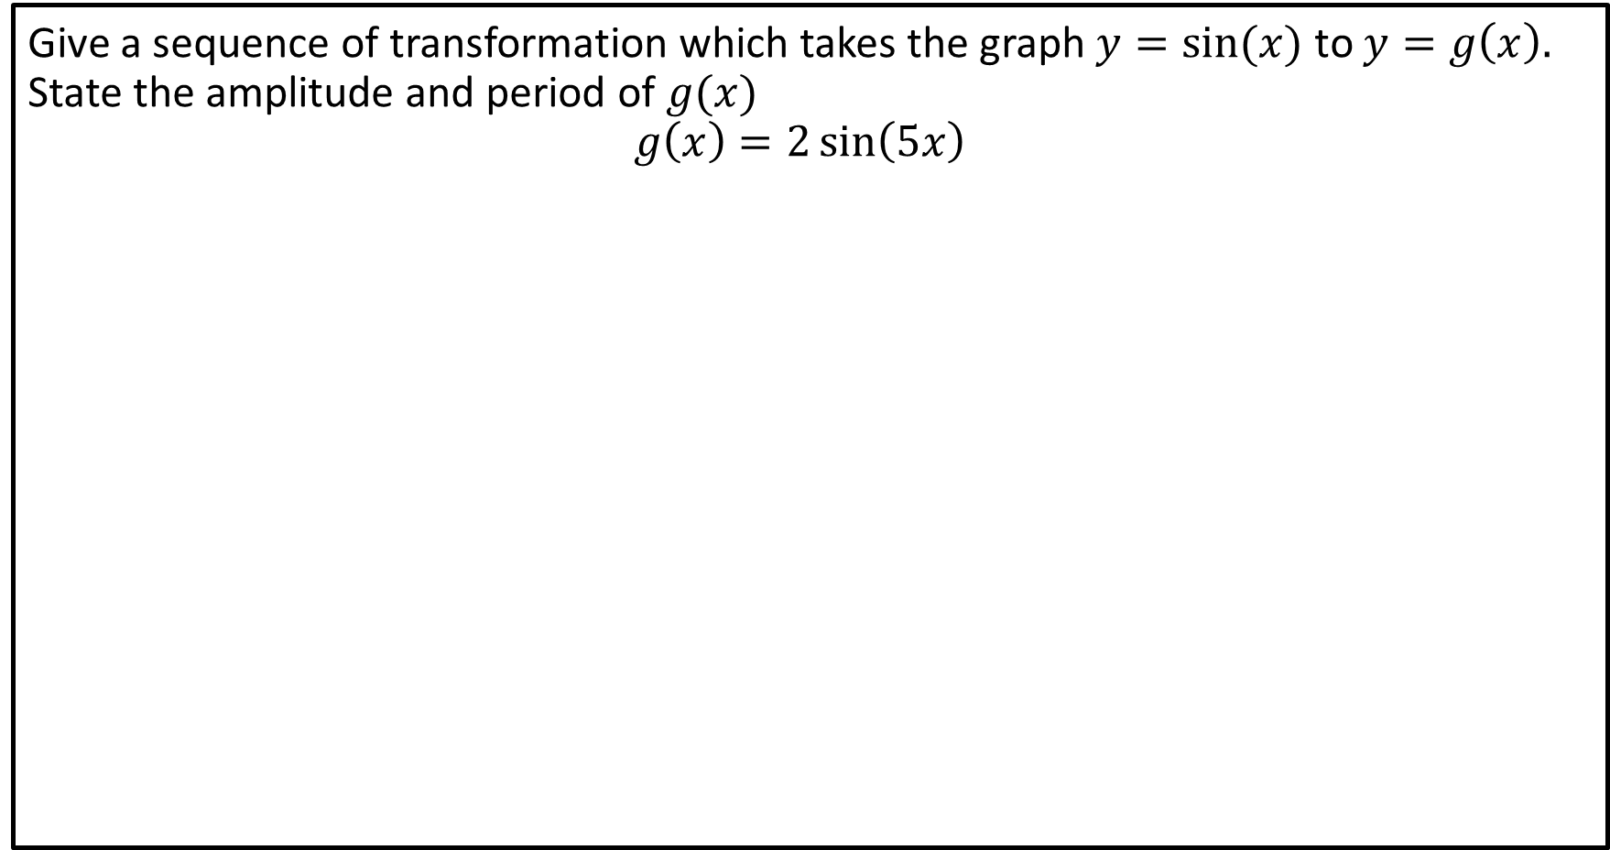
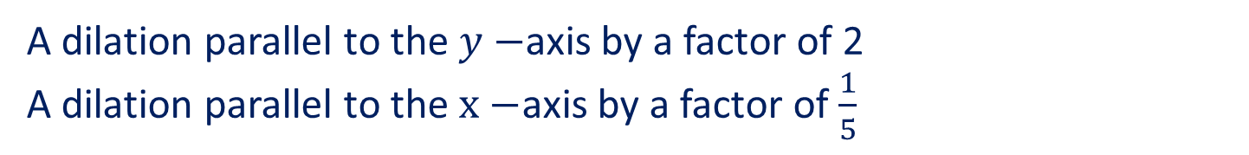


Guided Practice
Give a sequence of transformation which takes the graph $y=sin⁡(x)$ to $y=g\left(x\right).$ State the amplitude and period of $g(x)$
$$g\left(x\right)=2\sin\left(5x\right)$$
Amplitude=$2$
Period=$\frac{2π}{b}=\frac{2π}{5}$
A dilation parallel to the $y−$axis by a factor of 2
A dilation parallel to the $x−$axis by a factor of $\frac{1}{5}$

Slide 18
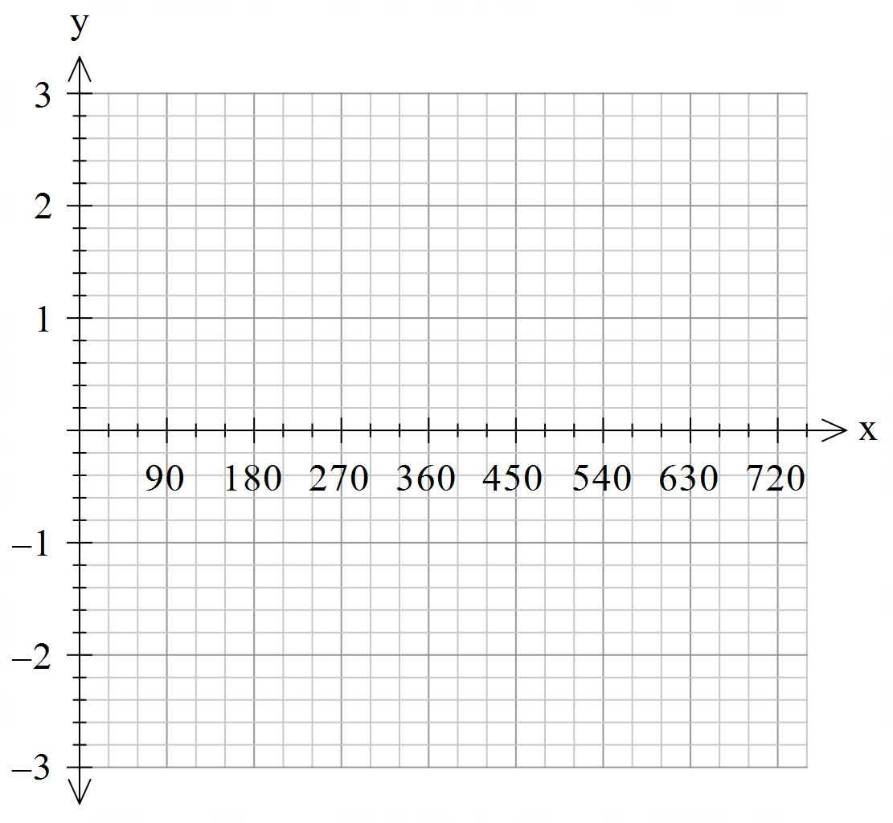



Guided Practice
a) State the amplitude and period of $y = −2cos⁡(2x)$.
b) Sketch the function on the axes below, over the domain 0 ≤ x ≤ 720°.
Amplitude=$2$
Period=$\frac{2π}{2}=π$
Reflected about the x-axis
NOTE: When sketching,
Consider sin, cos or tan and amplitude to plot starting point.
Identify extrema using amplitude and period.

Slide 19
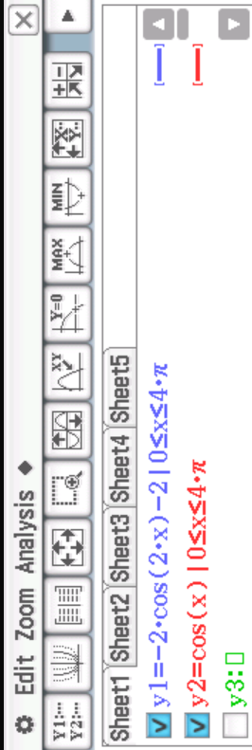
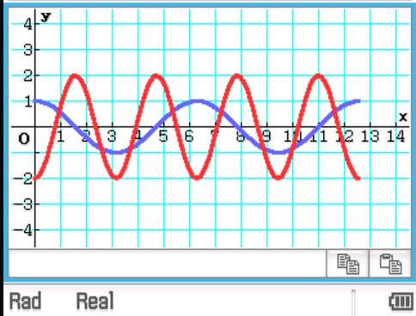

Guided Practice - ClassPad
a) State the amplitude and period of $y = −2cos⁡(2x)$.
b) Sketch the function on the axes below, over the domain 0 ≤ x ≤ 720°.
Amplitude=$2$
Period=$\frac{2π}{2}=π$
Reflected about the x-axis
NOTE: When sketching,
Consider sin, cos or tan and amplitude to plot starting point.
Identify extrema using amplitude and period.

Slide 20




Guided Practice
Sketch the graph, showing one complete cycle. State the amplitude and period.
$$y=4\sin\left(\frac{θ}{2}\right)$$
Amplitude=$4$
Period=$\frac{2π}{b}=4π$

Slide 21
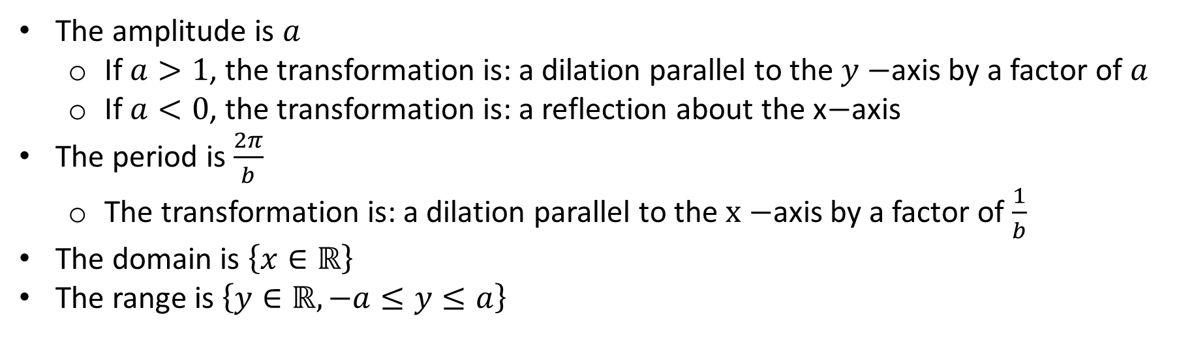

Summary Part 1
Given a trigonometric function (sine or cosine), $f(x)$
$$y=af\left(bx\right)$$
$$y=a\sin{(bx)}or y=acos⁡(bx)$$
The amplitude is $a$
If $a>1$, the transformation is: a dilation parallel to the $y−$axis by a factor of $a$
If $a<0$, the transformation is: a reflection about the x$−$axis
The period is $\frac{2π}{b}$
The transformation is: a dilation parallel to the $x−$axis by a factor of $\frac{1}{b}$
The domain is $\left\{x∈ℝ\right\}$
The range is $\left\{y∈ℝ, −a≤y≤a\right\}$

Slide 22
Independent Practice
Complete Cambridge Ex 12G

